Slide 1
Fundamentals of Microscopy Course
Light Properties and Optical Principles
Behzad Khajavi
^{Optical Engineer}
Bio-Imaging Resource Center
The Rockefeller University

Slide 2
Outline
Definitions
Electromagnetic fields and spectrum
EM field propagation (reflection, refraction)
EM field interference and diffraction
Manipulation of light rays
Building a basic microscope
Imaging, resolution, numerical aperture

Slide 3
Definition
Optics: branch of Physics that studies the behavior and properties of light, its generation, propagation, interaction with matter, and detection.
Light: electromagnetic radiation that can be detected by the human eye; shows both wave and particle characteristics (visible EM).
Photon: the smallest discrete amount or quantum of electromagnetic radiation; has zero (rest) mass and travels at c = 299,792,458 m/s.
Quantum Optics
Electromagnetic Optics
Wave Optics
Classical Optics
Ray Optics
Photonics: science and technology of generating, controlling, and detecting photons (i.e., “particles” of light).
Biophotonics: optics with an emphasis on interaction of light with biological tissues
Biomedical Optics: design and application of advanced optical techniques to solve problems in medicine and biology

Slide 4
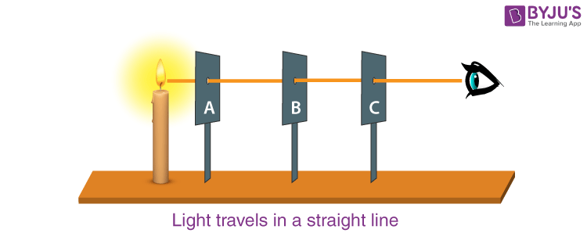
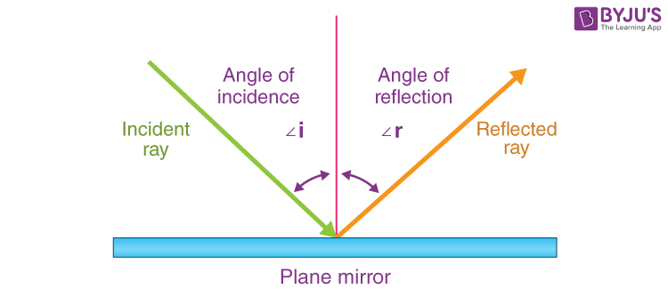
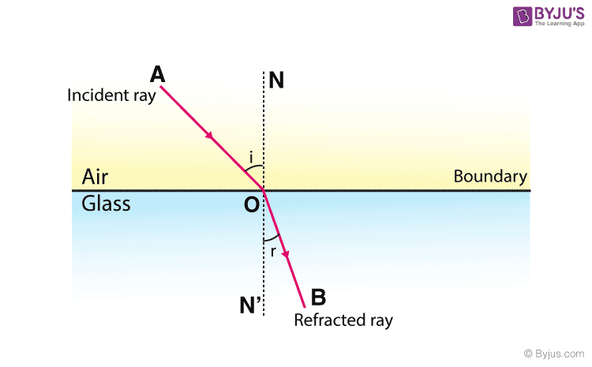
Basis of geometrical optics
Rectilinear propagation of light rays
Law of reflection,
(Euclid ~ 300 BC)
shortest path,
(Hero’s principle ~100 A.D.)
law of refraction,
dates to Ptolemy (~170 A.D.)

Slide 5
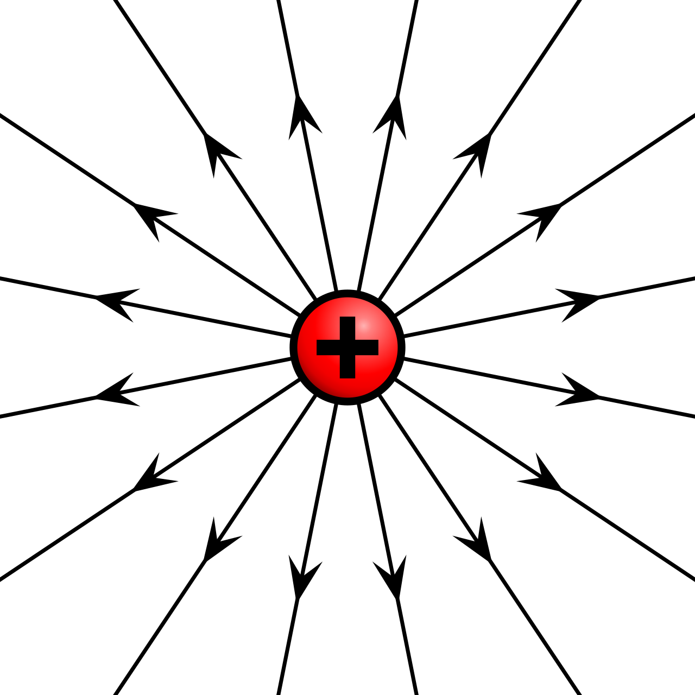
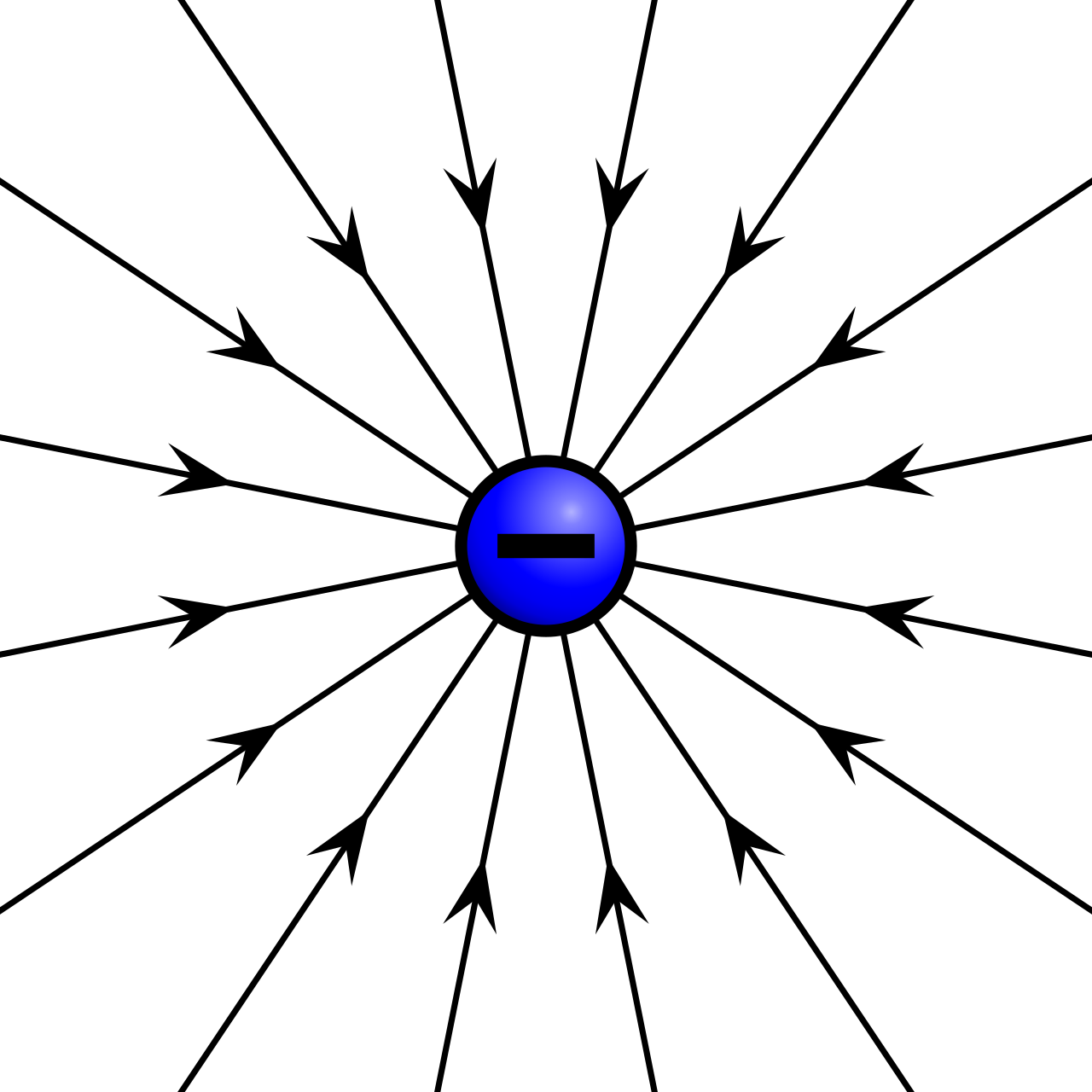
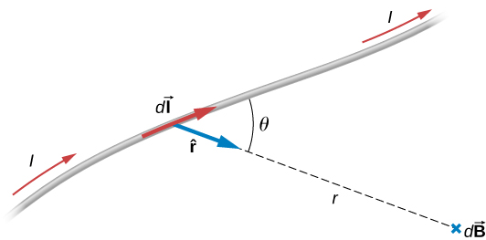
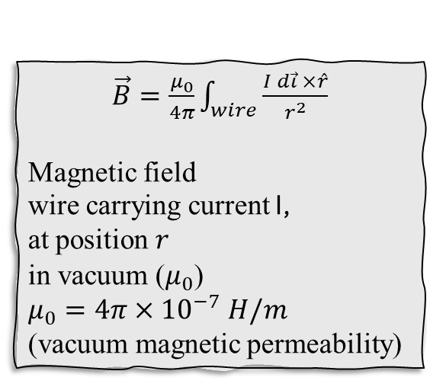
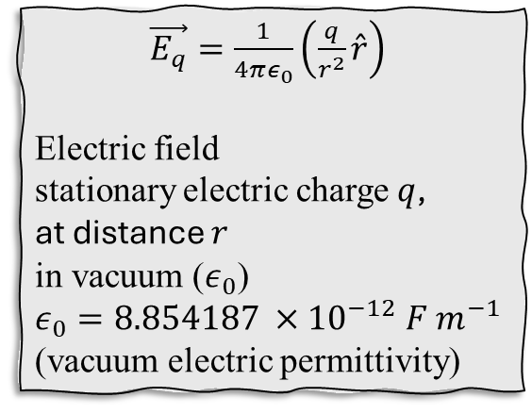
Electric and magnetic fields
$\vec{E_{q}}=\frac{1}{4πε_{0}}\left(\frac{q}{r^{2}}\hat{r}\right)$
Electric field
stationary electric charge $q$,
at distance $r$
in vacuum ($ε_{0}$)
$ε_{0}=8.854187 ×{10}^{−12} F m^{−1}$
(vacuum electric permittivity)
$\vec{B}=\frac{μ_{0}}{4π}\int_{wire}^{ }{\frac{I d\vec{ι} ×\hat{r}}{r^{2}}}$
Magnetic field
wire carrying current I,
at position $r$
in vacuum ($μ_{0}$)
$μ_{0}=4π×{10}^{−7} H/m$
(vacuum magnetic permeability)

Slide 6
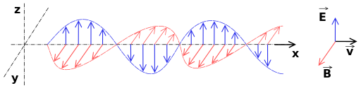
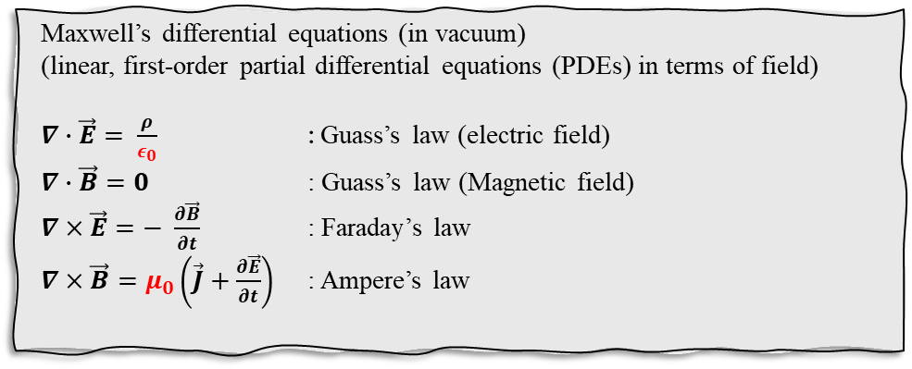
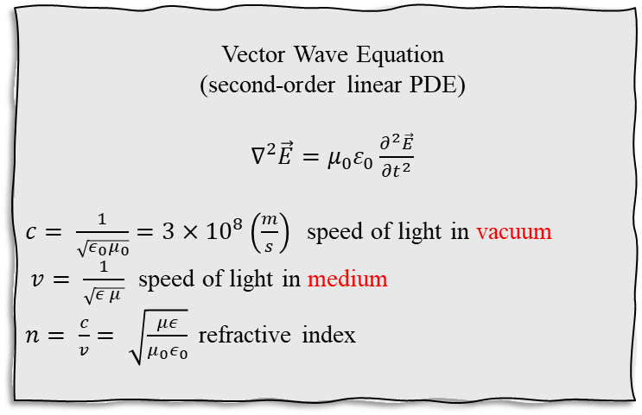
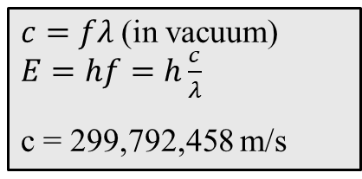

Electromagnetic fields
$$λ$$
$c=fλ$ (in vacuum) $E=hf=h\frac{c}{λ}$
c = 299,792,458 m/s
Vector Wave Equation
(second-order linear PDE)
$∇^{2}\vec{E}=μ_{0}ε_{0}\frac{∂^{2}\vec{E}}{{∂t}^{2}}$
$c= \frac{1}{\sqrt{ε_{0}μ_{0}}}=3×{10}^{8}\left(\frac{m}{s}\right)$ speed of light in vacuum
$v= \frac{1}{\sqrt{ε_{ }μ_{ }}}$ speed of light in medium
$n= \frac{c}{v}= \sqrt{\frac{με}{μ_{0}ε_{0}}}$ refractive index
Maxwell’s differential equations (in vacuum)
(linear, first-order partial differential equations (PDEs) in terms of field)
$∇∙\vec{E}= \frac{ρ}{ε_{0}}$ : Guass’s law (electric field)
$∇∙\vec{B}=0$ : Guass’s law (Magnetic field)
$∇×\vec{E}=− \frac{∂\vec{B}}{∂t}$ : Faraday’s law
$∇×\vec{B}=μ_{0}\left(\vec{J}+\frac{∂\vec{E}}{∂t}\right)$ : Ampere’s law

Slide 7
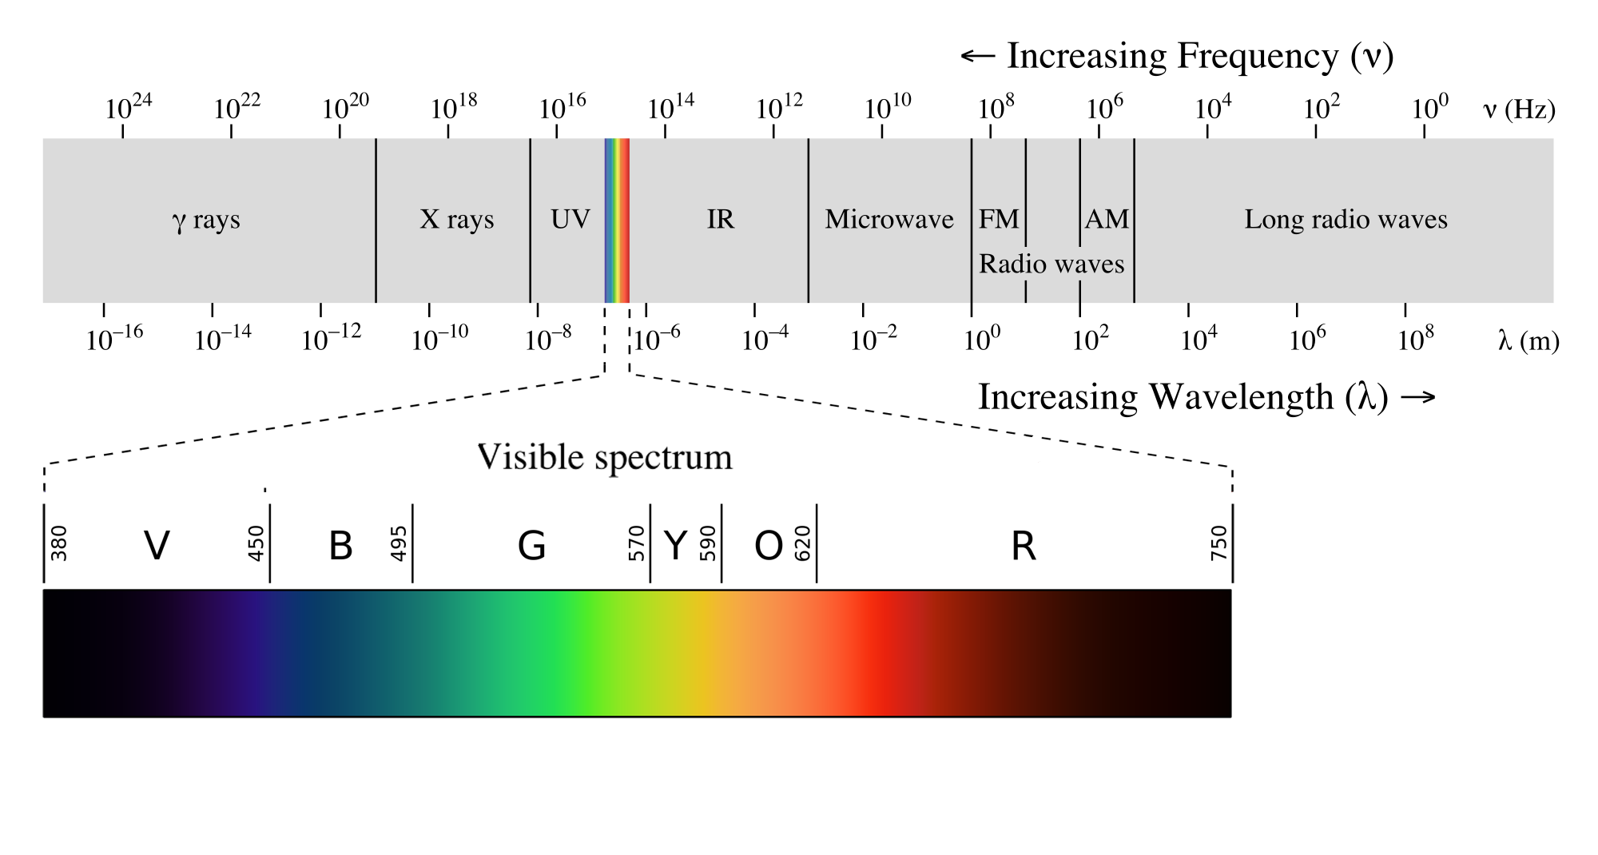
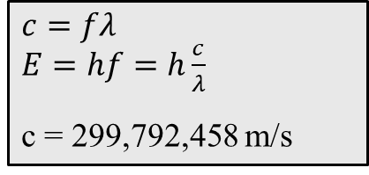
Electromagnetic spectrum
https://w.wiki/Hzx3
$c=fλ$ $E=hf=h\frac{c}{λ}$
c = 299,792,458 m/s

Slide 8
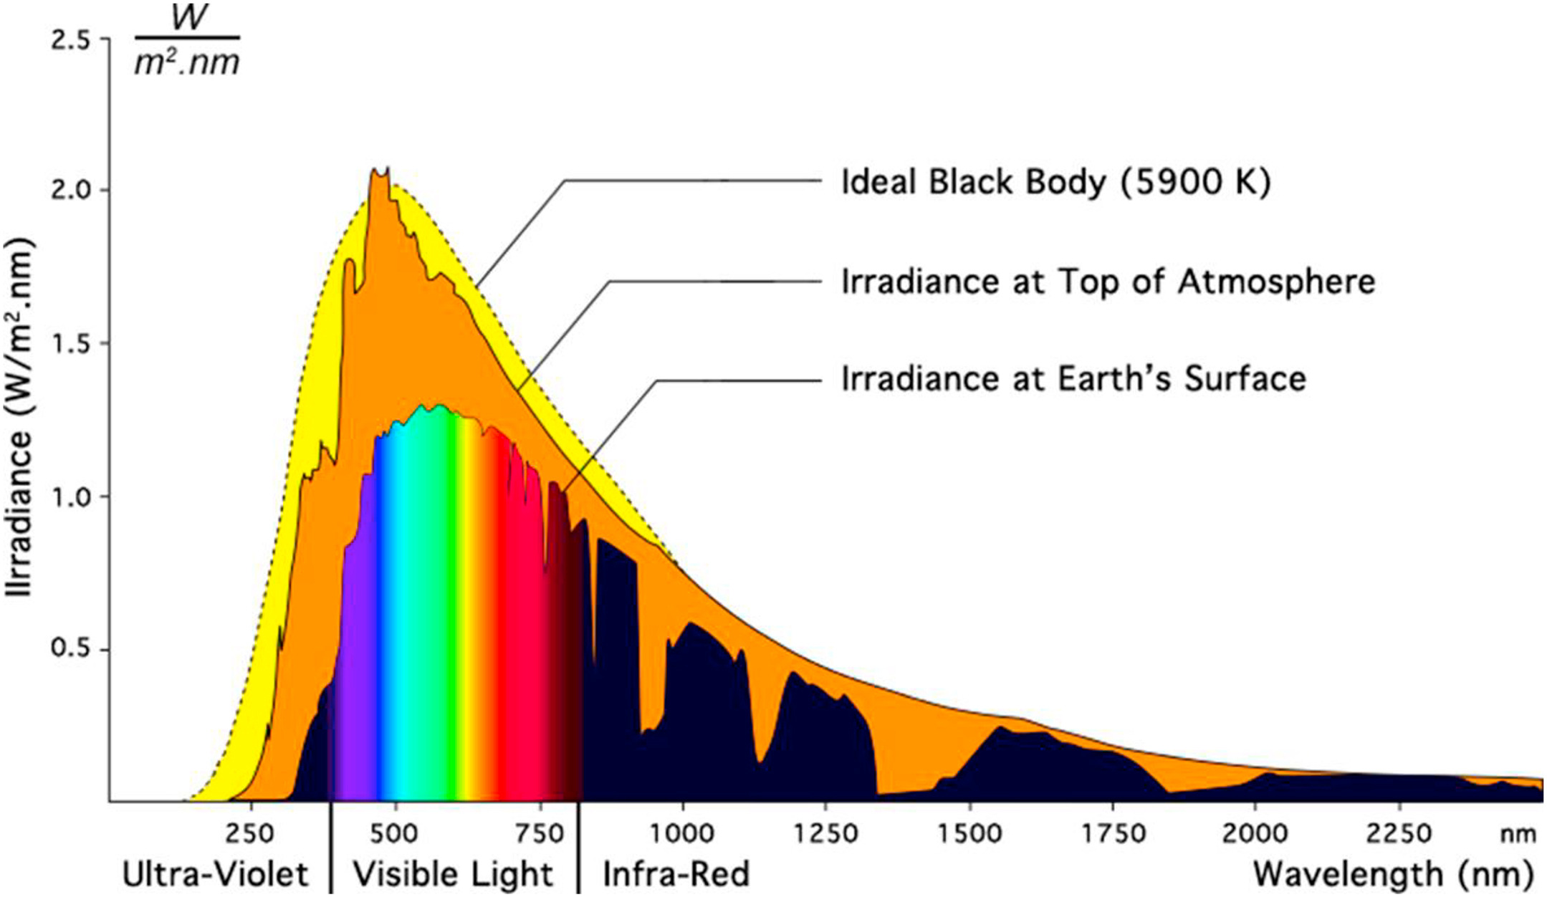
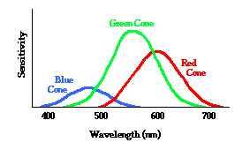
Electromagnetic spectrum
human eye cone sensitivity curve

Slide 9
EM field - Polarization
EM wave is a transverse wave. Electric field vector oscillations determines the polarization:
Linear, Circular, Elliptical
0 θ π/2
0
χ
π/2
RCP
LP
LCP

Slide 10
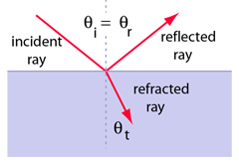



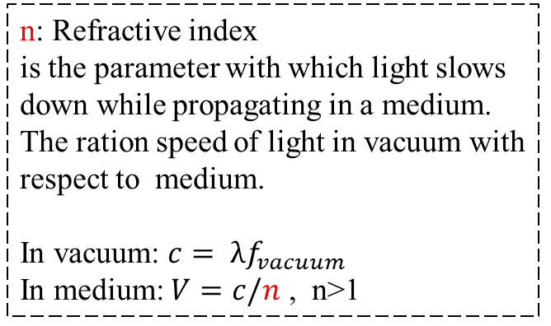

EM field - propagation
Reflection
$$n_{1}$$
Reflection
$$θ_{i}=θ_{r}$$
$$n_{2}$$
http://hyperphysics.phy-astr.gsu.edu/hbase/phyopt/reflectcon.html#c1
https://commons.wikimedia.org/wiki/File:Internal-reflection.gif
Refraction
n: Refractive index
is the parameter with which light slows down while propagating in a medium.
The ration speed of light in vacuum with respect to medium.
In vacuum: $c= λf_{vacuum}$
In medium: $V=c/n$ , n>1
Refraction: Snell’s law
$$n_{1}\sin{θ_{i}}=n_{2}\sin{θ_{t}}$$
https://en.wikipedia.org/wiki/Refraction

Slide 11
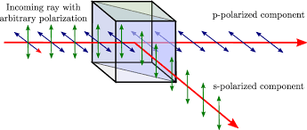
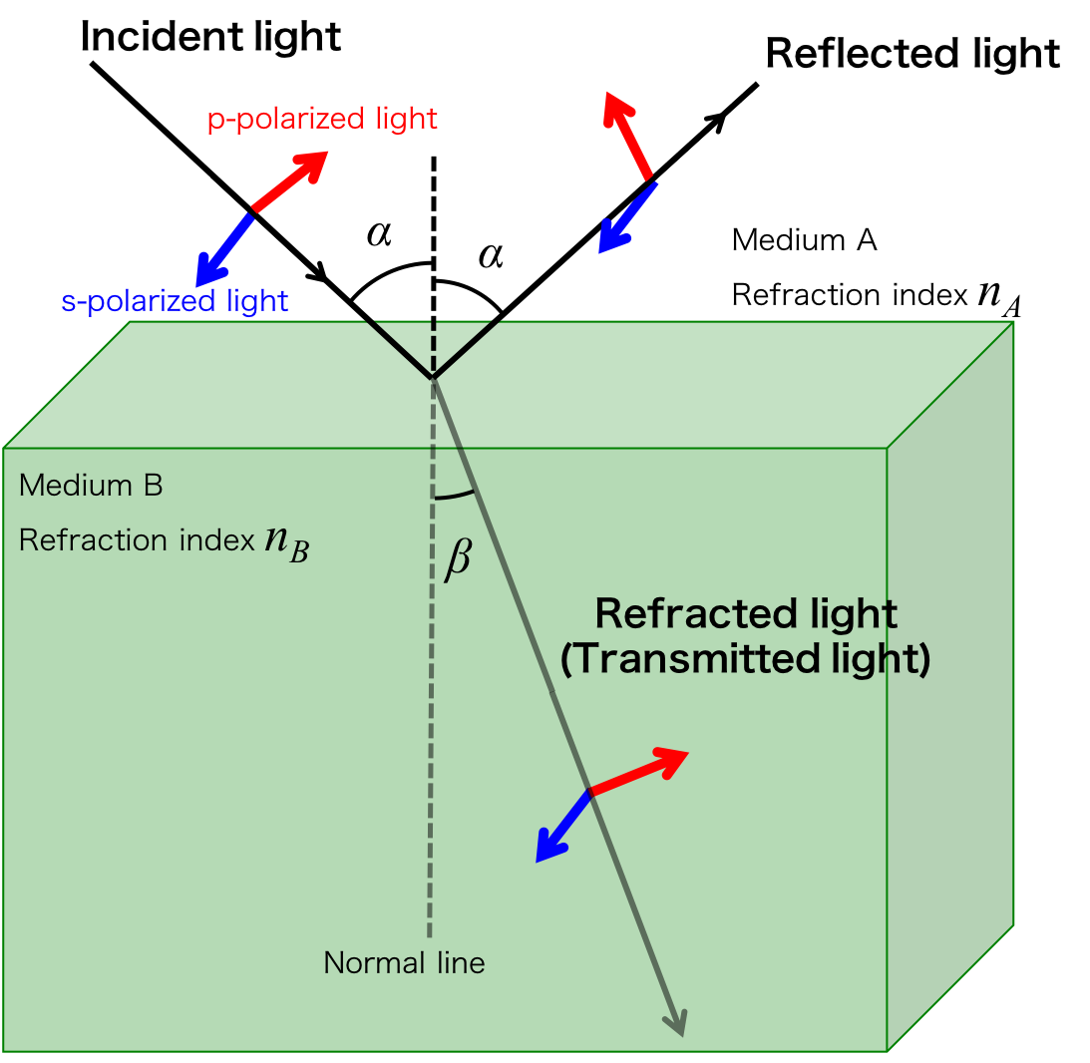
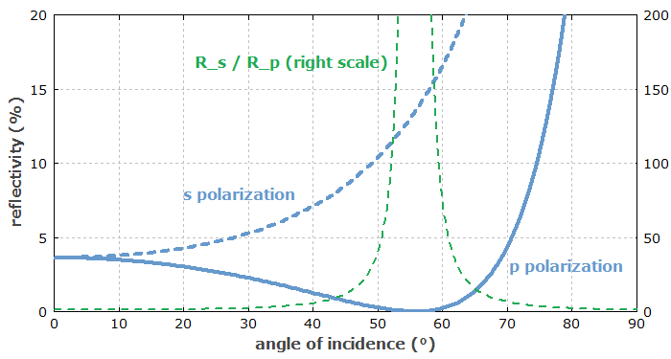
EM field - propagation
Polarization effect in Reflection and Refraction
Polarizing BS in microscopes
Refraction simulation
Fresnel equations
physics.thick.jp

Slide 12
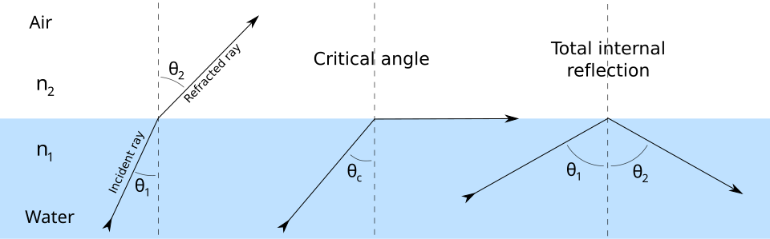
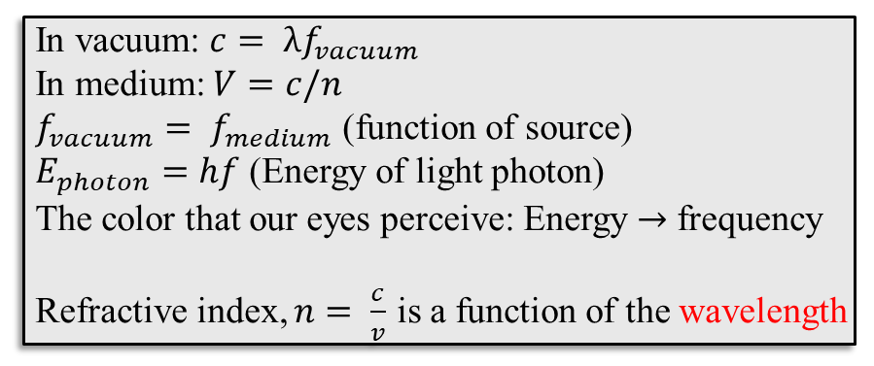
EM field - propagation
Refractive Index and Total Internal Reflection
Material | n
air | 1
water | 1.33
PBS | 1.37
Immersion oil | 1.52
glass | 1.46 - 1.8
https://en.wikipedia.org/wiki/Reflection_(physics)#Laws_of_reflection
In vacuum: $c= λf_{vacuum}$
In medium: $V=c/n$
$f_{vacuum}= f_{medium}$ (function of source)
$E_{photon}=hf$ (Energy of light photon)
The color that our eyes perceive: Energy $→$ frequency
Refractive index, $n= \frac{c}{v}$ is a function of the wavelength
Refractive index of most biological specimen is around 1.4

Slide 13
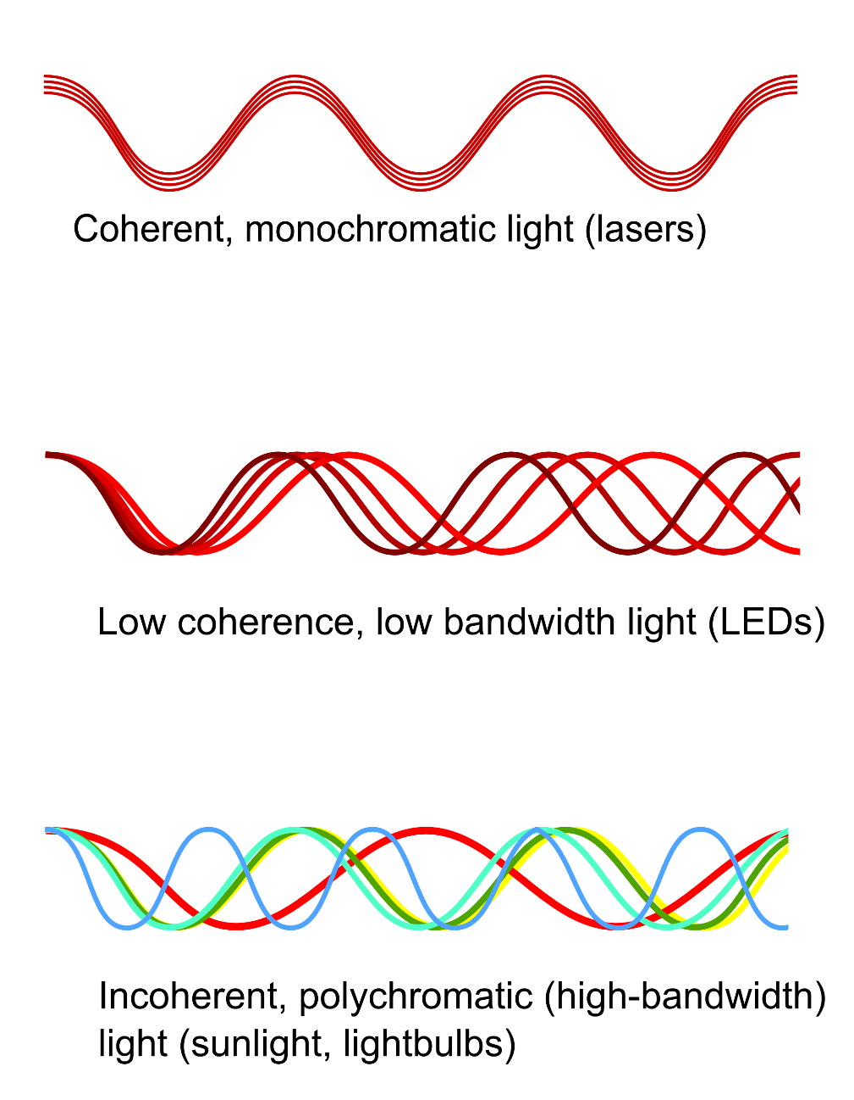
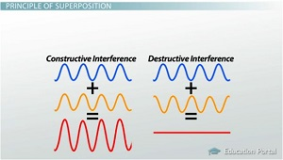
EM field - Coherence and Interference
Coherent light: well-defined relationship in phase at different points in space (wavelength dependent)
Generates constructive and destructive interference- useful for looking at path-length differences and moving light-scatterers
Constructive Interference
Destructive Interference
http://study.com/cimages/multimages/16/

Slide 14
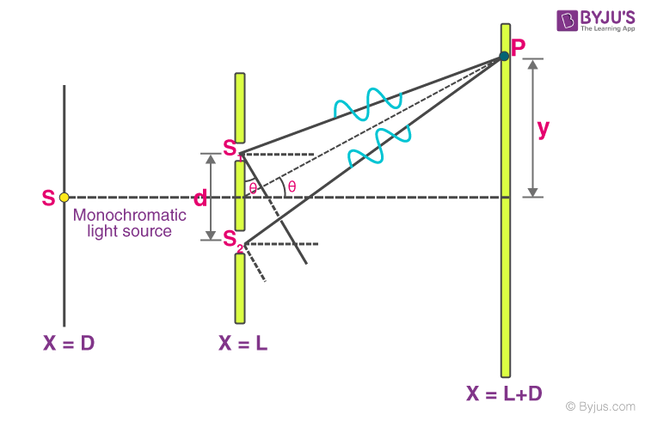
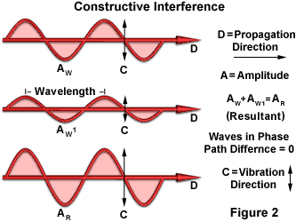
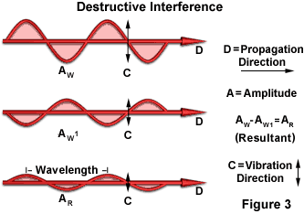
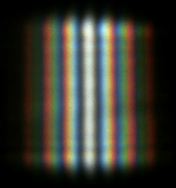

EM field - Interference
Interference and Young’s double slit experiment
https://evidentscientific.com/en/microscope-resource/knowledge-hub/lightandcolor/interference
double slit interference of sunlight
For small $θ:\tan{θ}≈θ≈\sin{θ_{ }}≈\frac{λ}{d}$

Slide 15
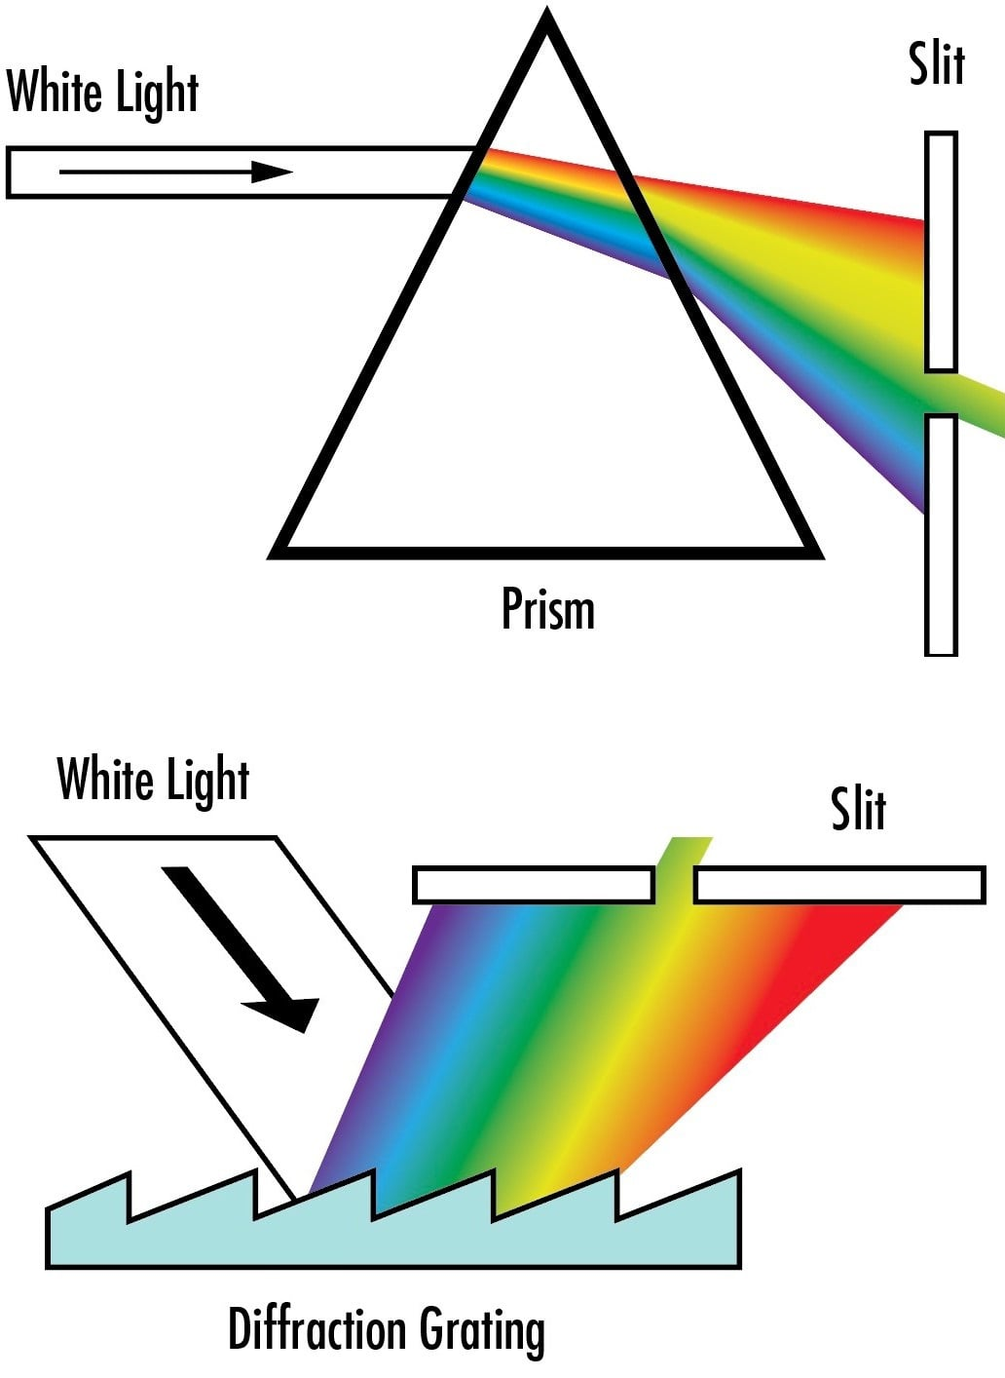
EM field - Diffraction
Superposition of many interferences from an aperture (wavelength dependent)
Double slit simulation
MATLAB app
[Most accurate approximation]
Rayleigh-Sommerfeld
Fresnel
Fraunhofer
[Least accurate approximation].
dispersion prisms separate wavelengths through refraction (top)
diffraction gratings separates wavelengths through diffraction (bottom)
EdmundOptics
Notes:
Demo gratings and laser pointers?

Slide 16
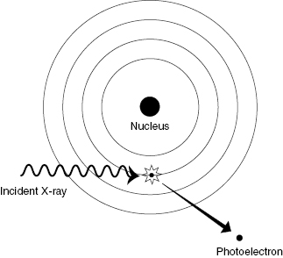
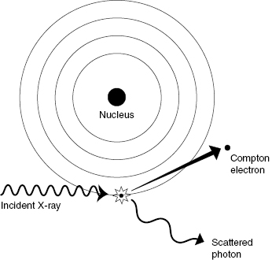
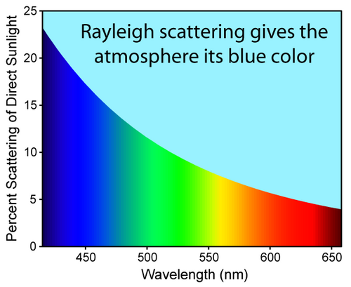
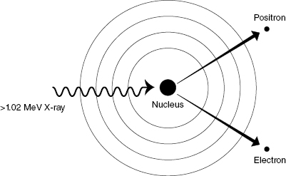

Light Interaction with Matter
Longer Wavelength : Rayleigh scattering $↓$
Photoelectric absorption
Scattering
(Compton, Rayleigh,…)
Pair Production
https://radiologykey.com/4-radiation-interactions-with-tissue/

Slide 17
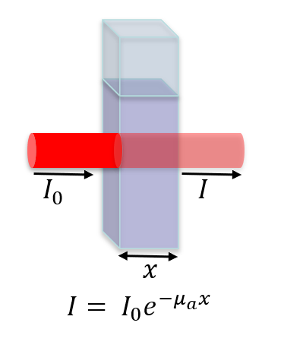
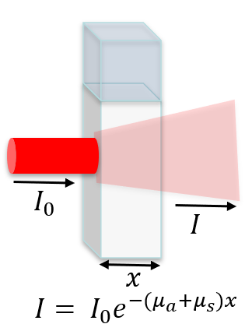
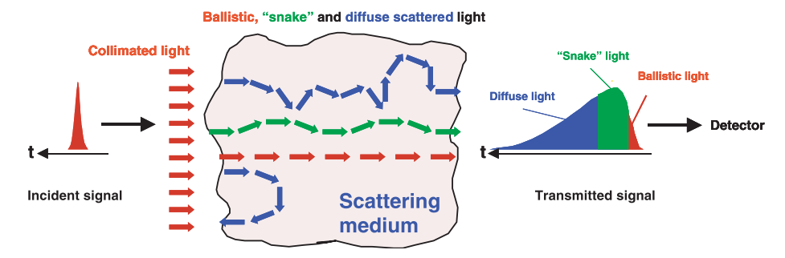
Light Interaction with Matter
absorption
absorption + scattering
Light Propagation in Tissue
EM wave (in material)
https://emanim.szialab.org/index.html
C Dunsby and P M W French 2003 J. Phys. D: Appl. Phys. 36 R207

Slide 18
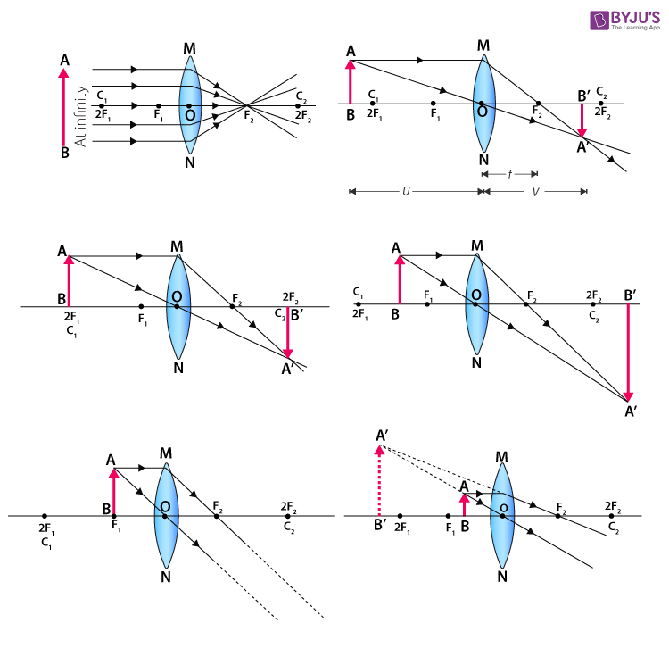
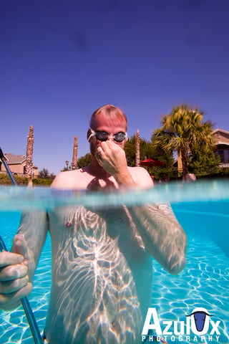
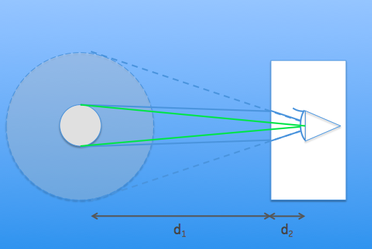
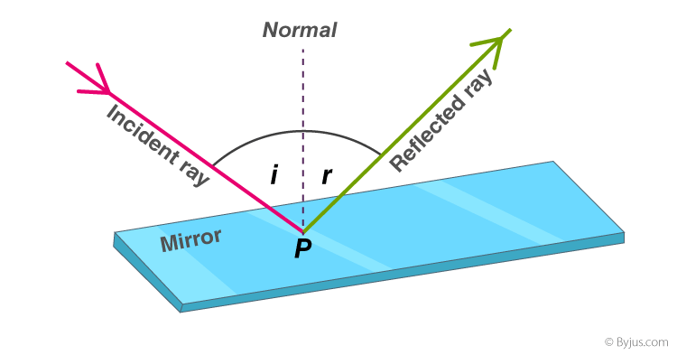
light ray manipulation
Refraction, Reflection, Image formation, (De)Magnification

Slide 19
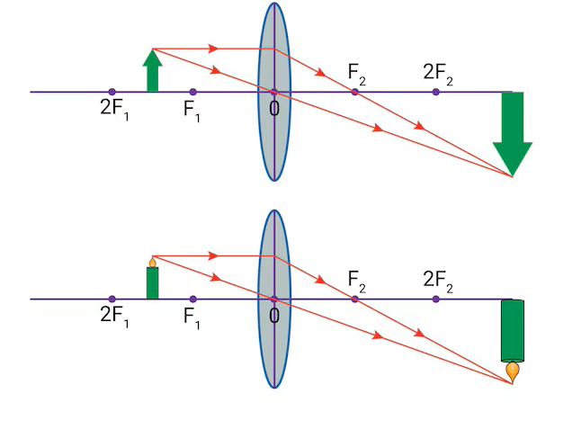
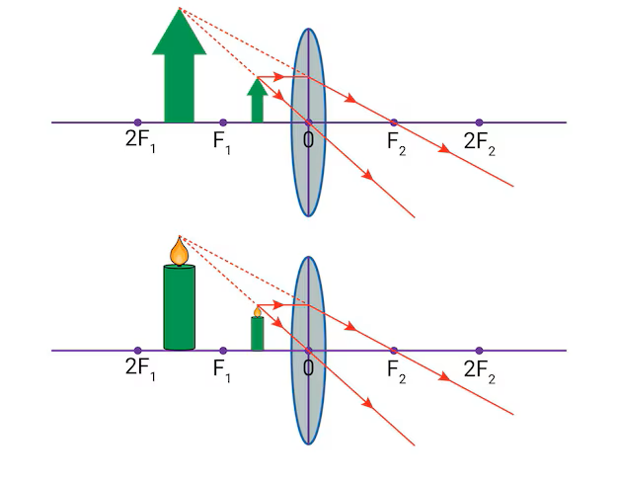
light ray manipulation
Ray diagram for a converging lens
Rays parallel to symmetry axis (optical axis) get focused (focal point).
Rays crossing the center point of the lens are not refracted.
Rays crossing the focal point, refract parallel to the optical axis.

Slide 20
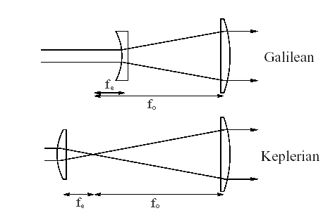
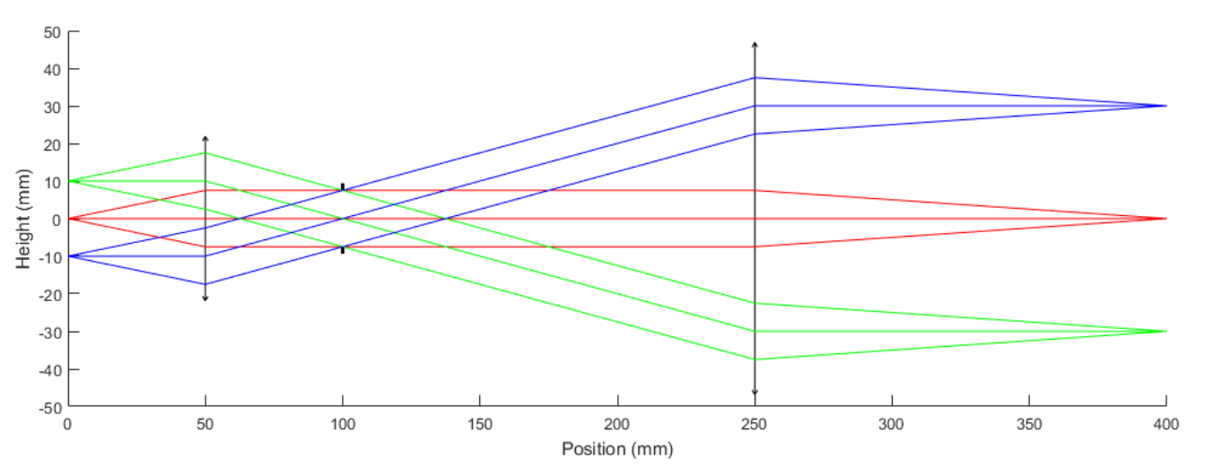
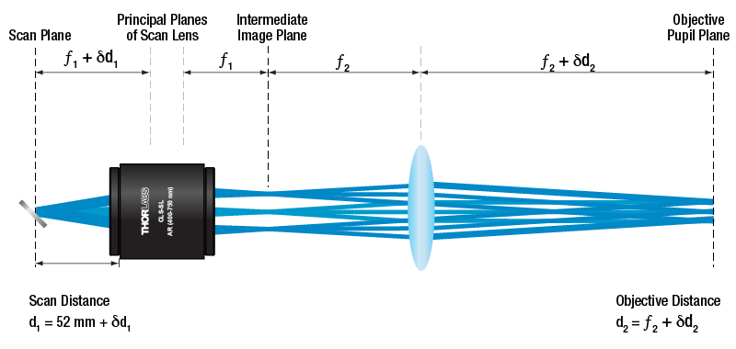
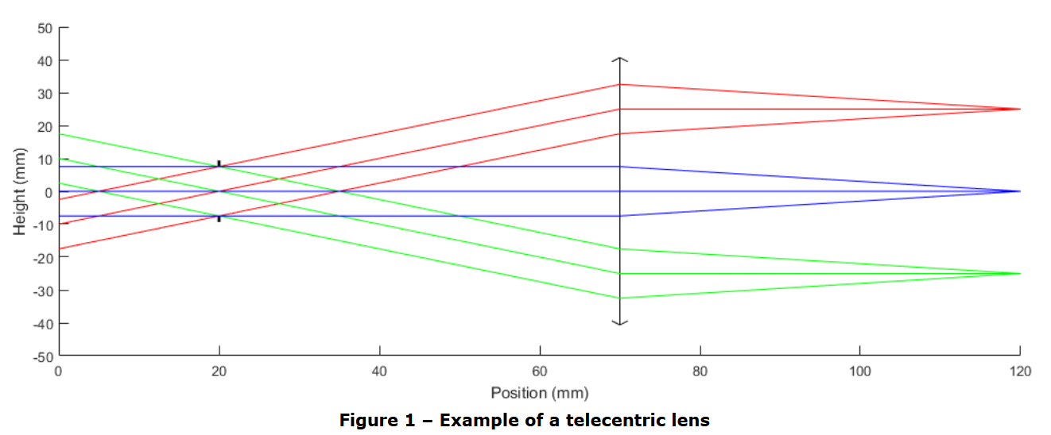
light ray manipulation – 4f system, telescopes, telecentric scan, etc.
4f system, separation = f1 + f2
www.thepulsar.be
Telecentric lens

Slide 21
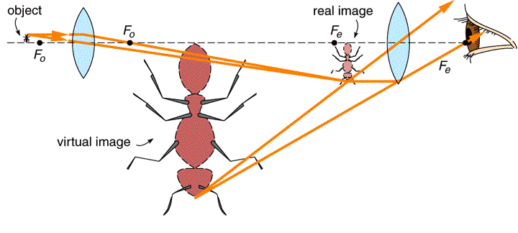
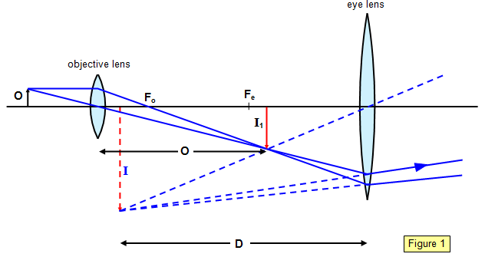
light ray manipulation – building microscope
https://www.schoolphysics.co.uk/
https://physics.stackexchange.com/

Slide 22
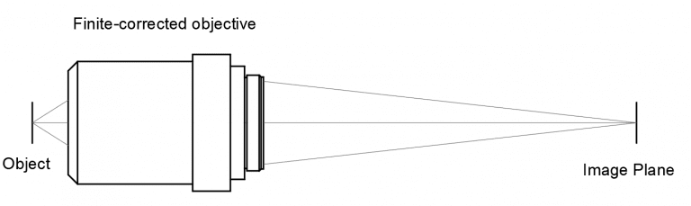


light ray manipulation – building microscope
https://micro.magnet.fsu.edu/

Slide 23



light ray manipulation – Objectives
Objectives come in various designs.
Dry, water, oil, NA, working distance, aberrations, etc.

Slide 24





Resolution and NA dependence
$$\tan{θ↑}≈\sin{{θ↑}_{ }}≈θ↑≈$$
$$λ$$
$$d↓$$
The angle of spreading (θ) is
inversely proportional to the size of the particles
finer periodic structures leaves the sample at a higher angle.
https://phys.libretexts.org/
Douglas B. Murphy Michael W. Davidson, Fundamentals of Light Microscopy..
Diffraction gratings Demo

Slide 25




Resolution and NA dependence
Numerical Aperture: $NA = n\sin{θ}$
n: refractive index
$θ$: is the half-angle of the maximum cone of light that can enter or exit the lens
The numerical aperture of a microscope objective is a measure of its ability to gather light and resolve fine specimen detail at a fixed object distance.
https://www.teledynevisionsolutions.com/learn/learning-center/scientific-imaging/resolution-and-numerical-aperture/

Slide 26





Image formation, PSF, and Resolution
https://svi.n
$$g=h ∗f$$
The image (g) = the convolution of the object ( f) and the PSF (h)
PSF: Point Spread Function (how a point-like object appears)
https://bioimagebook.github.io/
Abbe Lateral Res $\sim \frac{λ}{2 n\sin{α}}= \frac{λ}{2 NA}$
Abbe Axial Res $\sim \frac{2λ}{{\left(NA\right)}^{2} }$

Slide 27


Resolution and NA dependence
Lateral Res $\sim \frac{λ}{2 n\sin{α}}= \frac{λ}{2 NA}$
Axial Res $\sim \frac{2λ}{{\left(NA\right)}^{2} }$
If ${NA}_{cond} ≤ {NA}_{obj}$:
Lateral Res $\sim \frac{1.22 λ}{{NA}_{obj}+{NA}_{cond}}$ (Abbe formula)
https://zeiss-campus.magnet.fsu.edu/
In epi FL microscopes the objective acts as the condenser:
Lateral resolution: only objective NA

Slide 28



Diffraction limited resolution
Resolution Limit Imposed by Wave Nature of Light
Rayleigh Lateral Res $n\sin{θ_{ }}=\frac{λ}{2d}$
$d=0.61\frac{λ}{NA}$
https://bioimagebook.github.io/
The Rayleigh criterion : the minimum resolvable detail.
“The first diffraction minimum of the image of one source point coincides with the maximum of another.”

Slide 29




light ray manipulation – Kӧhler illumination
Uniform illumination using several lenses
https://zeiss-campus.magnet.fsu.edu/
www.teledynevisionsolutions.com/

Slide 30




Microscope main components
Illumination
Sources
Optical Components
Detectors
Data Acquisition
Components

Slide 31





Microscope main components – Illumination sources
Lowest coherency
Lamps
Broad spectral excitation
Cheap, Long-lasting, Poor spectral purity, Hard to focus into fibers, Portable systems
LEDs
High-power, Better coherence, Stable, Easy to couple w/ fibers, Delicate – easy to burn down, More expensive
Laser Diodes
Laser Systems
Desired bandwidth, wavelength, stability, frequency, high coherency, Most expensive
Highest coherency

Slide 32




Microscope main components - Optics
Mirrors:
Broadband dielectric, gold, cylindrical,
Concave,
Filters: Intensity (ND), bandpass, long/short pass, polarization, …
Lenses:
Aspheric, Achromatic,
Convex,
Concave,
Doublet,
Powell,
Cylindrical,
…
Beamsplitters: X/Y (50/50), Dichromatic, Polarizing,…

Slide 33






Microscope main components - Detectors
Photodiodes
(PN junction diode in reverse bias) cheap, high speed, moderate sensitivity
Avalanche Photo Diodes (APD) high gain/sensitivity, higher cost, more delicate
Photomultiplier tubes (PMT) very high gain/sensitivity, require high voltage, prone to damage, limited near-IR reach (< 850 nm)

Slide 34



Microscope main components - Detectors
Charge coupled devices (CCD)
Analog
Linked capacitors transfer charges
Cheap
Complementary metal–oxide–semiconductor (CMOS)
Digital
High speed
Low sensitivity
sCMOS (Scientific CMOS)
Very low noise

Slide 35



Microscope main components - DAQ components
Analog to Digital Card (Digitizer)
Camera (Detector array)
Frame Grabber
High Speed Data
Storage drive
Converts the analog signal pulses to digital ones
Transfers data …
Up to several GB/s data transfer speed
Converts the signal pulses from camera (detector array) to digital ones
Transfers data …

Slide 36








Microscope main components - DAQ components
Multifunction I/O Modules, BNC cables, fibers, etc.

Slide 37
Microscope main components - Software
Software (Acquisition & Processing)
Single detector
1
2
Signal data stream
N
Detector array
Camera frame width: N
Processing procedure could be composed of: Averaging, filtering/Noise removing methods, deconvolution, etc.
(Explained in second session of the course)
1
2
N
1
2
Camera frame height: M
M

Slide 38



Examples of noncommercial microscopes
aicjanelia.org/mosaic
mesospim.org
openspim.org

Slide 39
Thanks
Bio Imaging Resource Center team
Alison North,
Ivan Rey Suarez,
Tao Tong,
Ved Sharma,
Maria Belen Harreguy Alfonso,
Priyam Banerjee,

